Slide 1
Lecture 14: Into to Neural Nets
DS 503: Advanced Data Analytics
Instructor: Dr. Gagan Gupta
Based on MMDS Ch 14

Slide 2
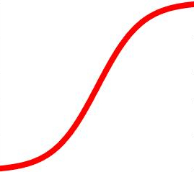

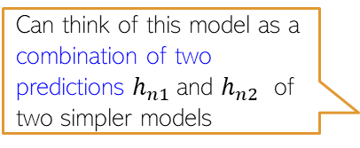
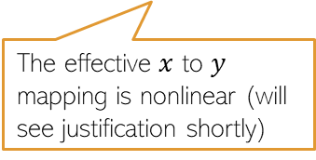
Neural Networks: Multi-layer Perceptron (MLP)
An MLP consists of an input layer, an output layer, and one or more hidden layers
Output Layer
(with a scalar-valued output)
Hidden layer units/nodes act as new features
Learnable weights
Hidden Layer
(with K=2 hidden units)
Can think of this model as a combination of two predictions $h_{n1}$and $h_{n2}$ of two simpler models
The effective $x$ to $y$ mapping is nonlinear (will see justification shortly)
Input Layer
(with D=3 visible units)

Slide 3
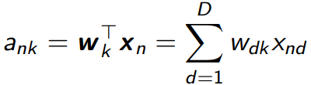
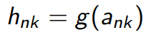
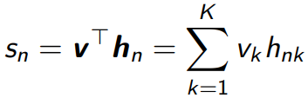
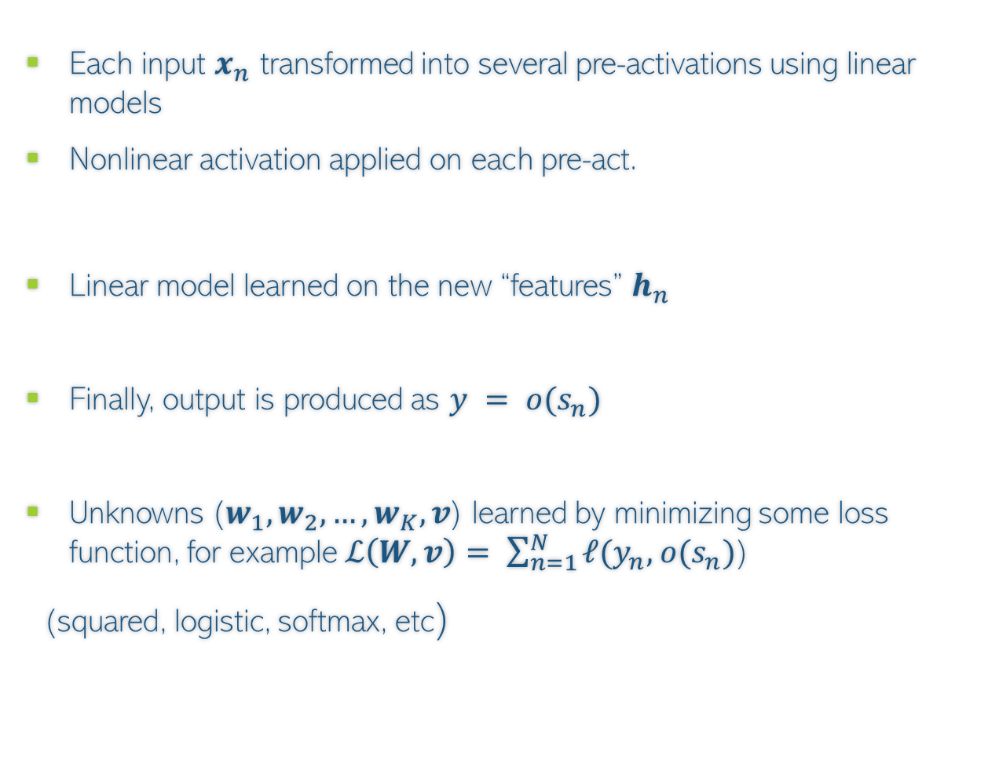
Illustration: Neural Net with One Hidden Layer
Each input $x_{n}$ transformed into several pre-activations using linear models
Nonlinear activation applied on each pre-act.
Linear model learned on the new “features” $h_{n}$
Finally, output is produced as $y = o(s_{n})$
Unknowns ($w_{1}, w_{2}, …, w_{K}, v$) learned by minimizing some loss function, for example $ℒ\left(W,v\right)= \sum_{n=1}^{N}{ℓ(y_{n},}$ $o(s_{n})$)
(squared, logistic, softmax, etc)
Can even be identity
(e.g., for regression y_{n} = s_{n} )

Slide 4
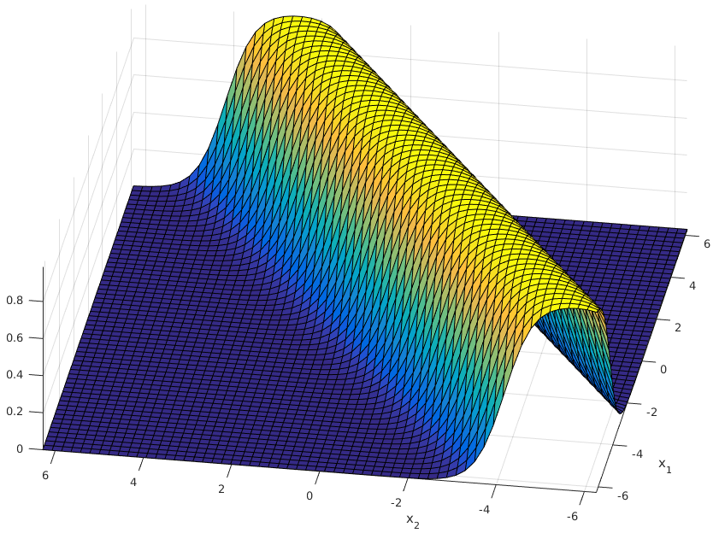
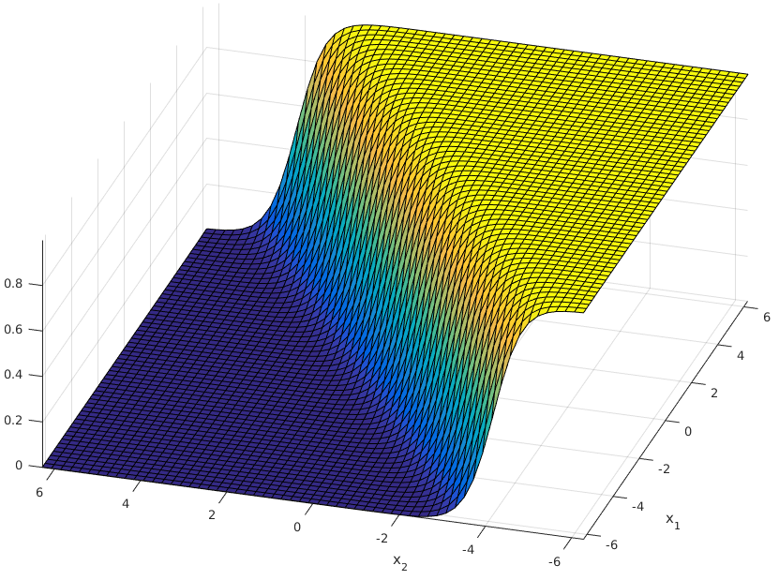
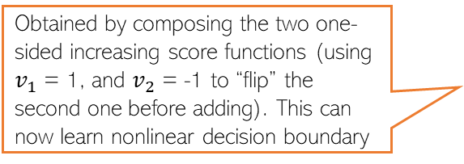
MLP Can Learn Nonlin. Fn: A Brief Justification
4
An MLP can be seen as a composition of multiple linear models combined nonlinearly
Obtained by composing the two one-sided increasing score functions (using $v_{1}$ = 1, and $v_{2}$ = -1 to “flip” the second one before adding). This can now learn nonlinear decision boundary
High-score in the middle and low-score on either of the two sides of it. Exactly what we want for the given classification problem
score
Score monotonically increases. One-sided increase (not ideal for learning nonlinear decision boundaries)
score
score
score
A nonlinear classification problem
Standard Single “Perceptron” Classifier (no hidden units)
A single hidden layer MLP with sufficiently large number of hidden units can approximate any function (Hornik, 1991)
A Multi-layer Perceptron Classifier
(one hidden layer with 2 units)
Capable of learning nonlinear boundaries

Slide 5








Example (Learning Non-Linear Boundaries)

Slide 6









Neural Net Designs

Slide 7
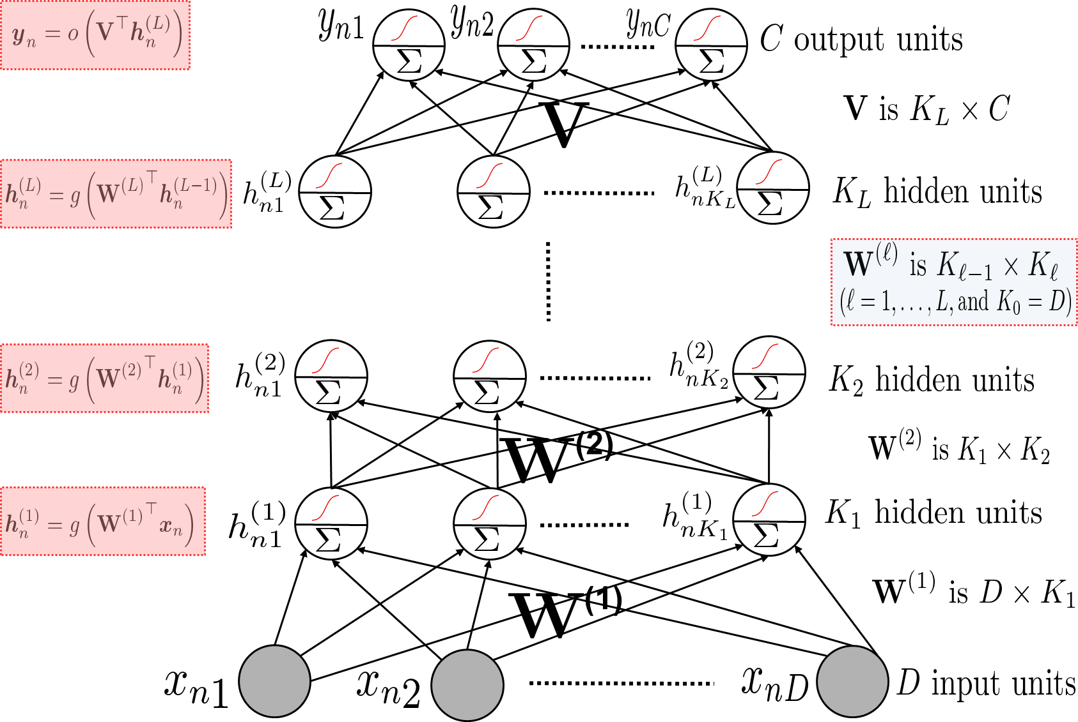
Multiple Hidden Layers (One/Multiple Outputs)
Most general case: Multiple hidden layers with (with same or different number of hidden nodes in each) and a scalar or vector-valued output

Slide 8
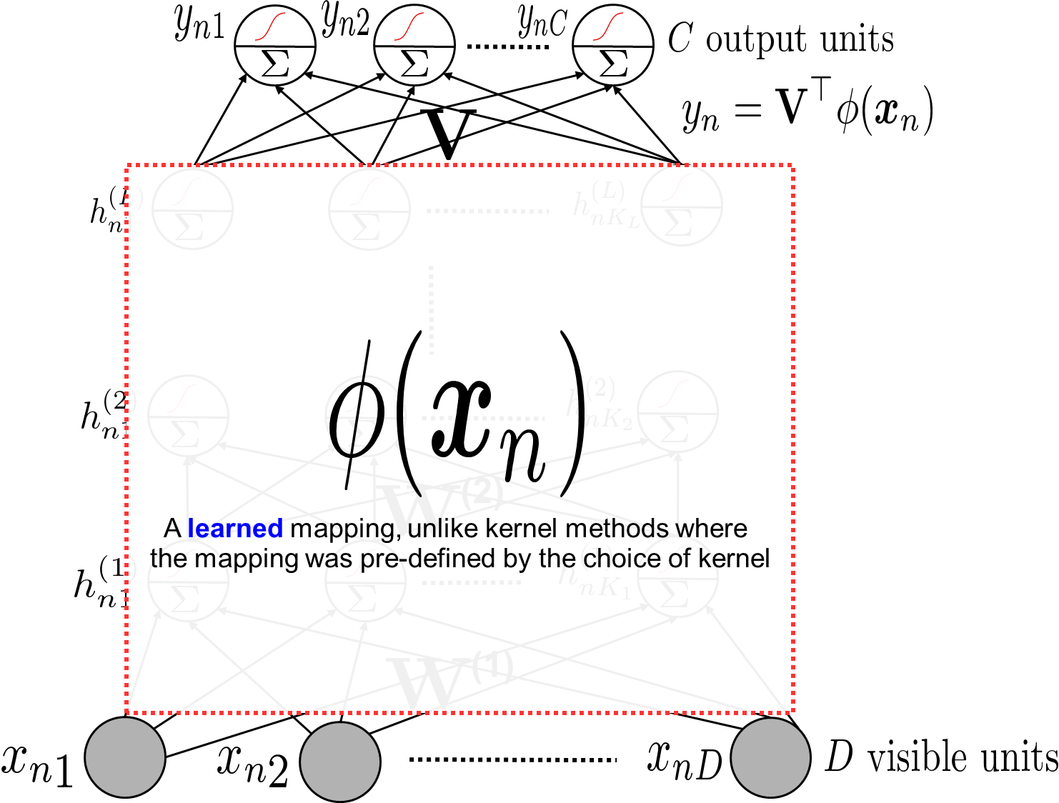
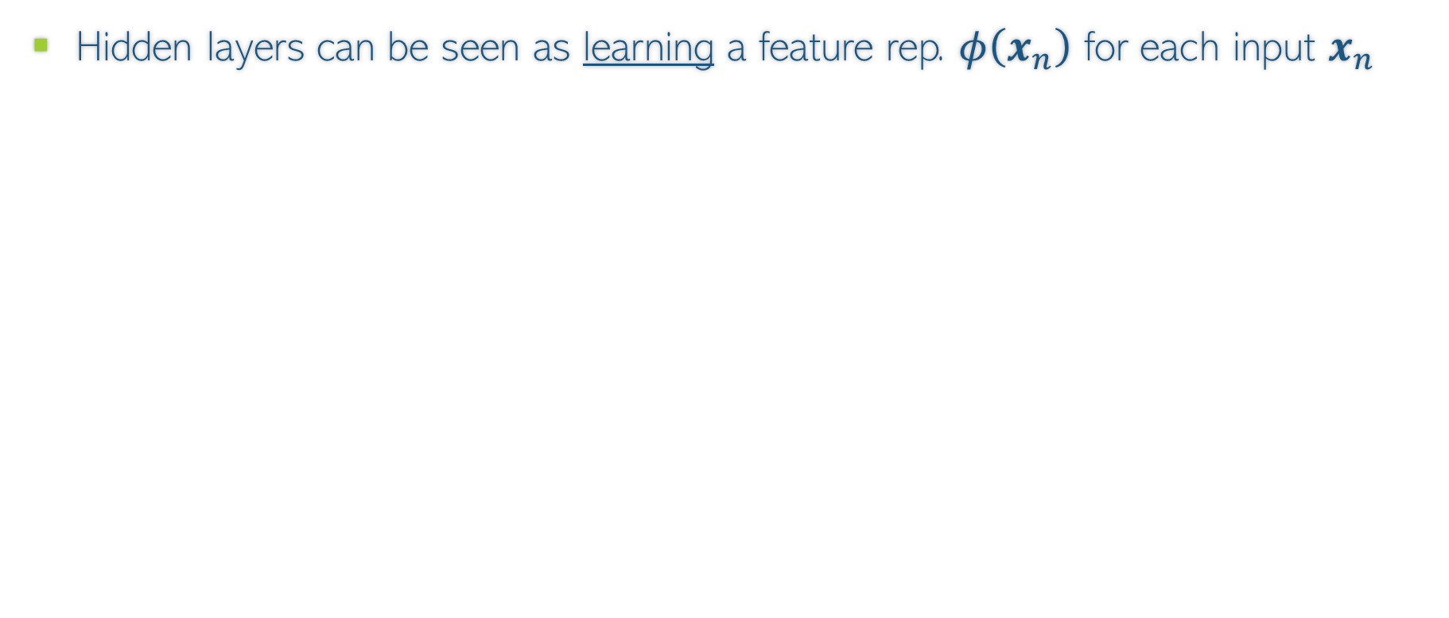
Neural Nets are Feature Learners/Encoders
Hidden layers can be seen as learning a feature rep. $φ\left(x_{n}\right)$ for each input $x_{n}$
The last hidden layer’s values

Slide 9
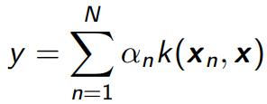
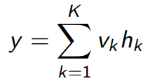
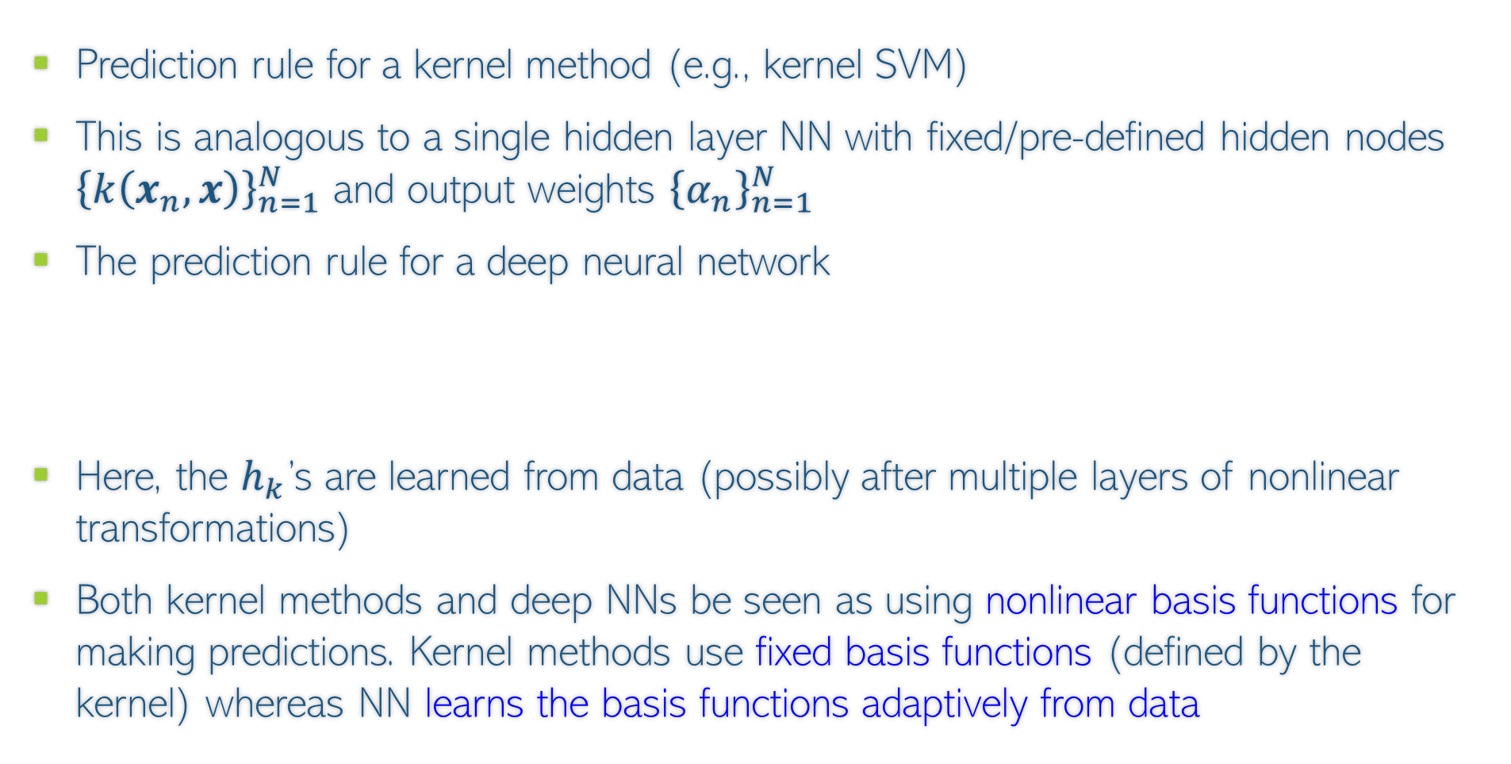
Kernel Methods vs Neural Nets
Prediction rule for a kernel method (e.g., kernel SVM)
This is analogous to a single hidden layer NN with fixed/pre-defined hidden nodes ${\left\{k\left(x_{n}, x\right)\right\}}_{n=1}^{N}$ and output weights ${\left\{α_{n}\right\}}_{n=1}^{N}$
The prediction rule for a deep neural network
Here, the $h_{k}$’s are learned from data (possibly after multiple layers of nonlinear transformations)
Both kernel methods and deep NNs be seen as using nonlinear basis functions for making predictions. Kernel methods use fixed basis functions (defined by the kernel) whereas NN learns the basis functions adaptively from data
Also note that neural nets are faster than kernel methods at test time since kernel methods need to store the training examples at test time whereas neural nets do not

Slide 10
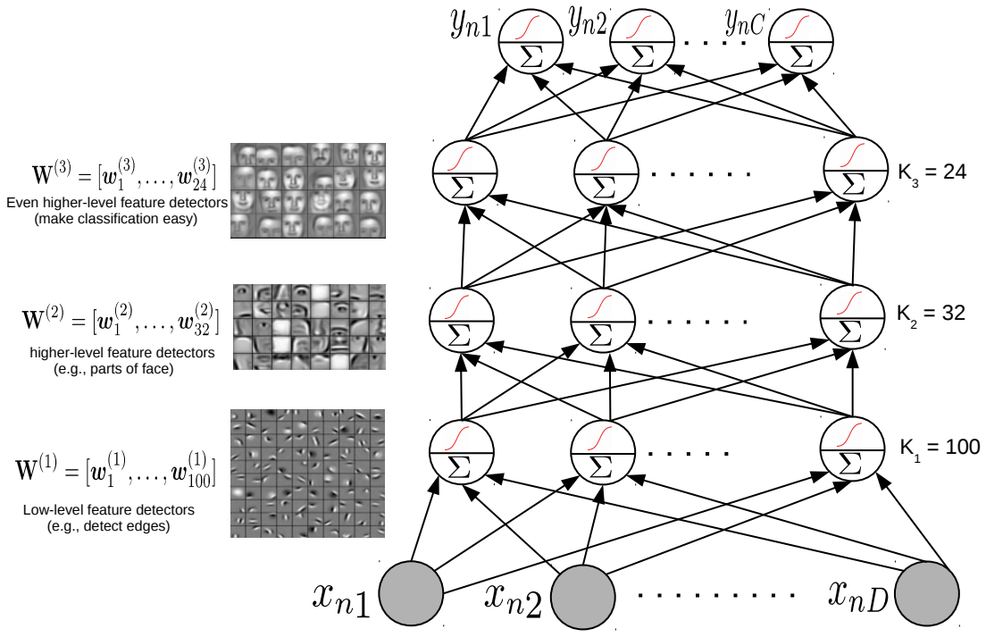
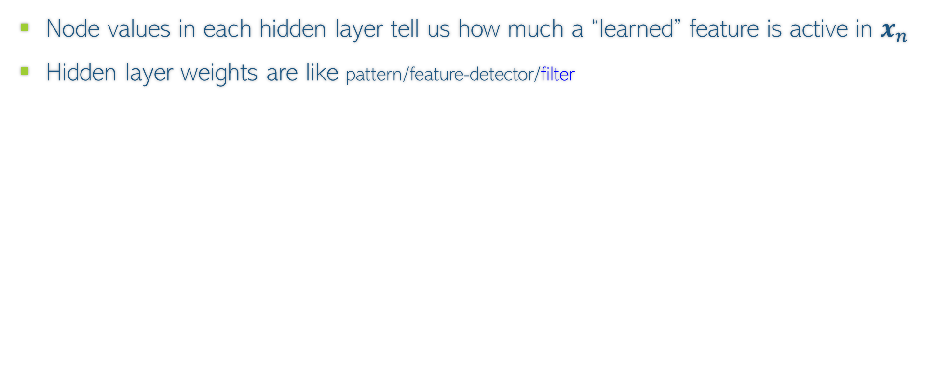

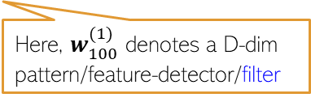
Feature Learned by a Neural Network
Node values in each hidden layer tell us how much a “learned” feature is active in $x_{n}$
Hidden layer weights are like pattern/feature-detector/filter
All the incoming weights (a vector) on this hidden node can be seen as representing a pattern/feature-detector/filter
Here, $w_{32}^{(2)}$ denotes a $K_{1}$-dim template/pattern/feature-detector
All the incoming weights (a vector) on this hidden node can be seen as representing a template/pattern/feature-detector
Here, $w_{100}^{(1)}$ denotes a D-dim pattern/feature-detector/filter

Slide 11
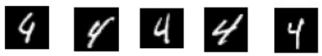
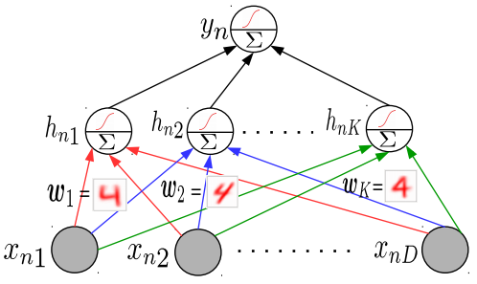
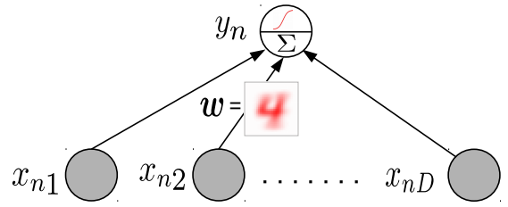
Why Neural Networks Work Better: Another View
Linear models tend to only learn the “average” pattern
Deep models can learn multiple patterns (each hidden node can learn one pattern)
Thus deep models can learn to capture more subtle variations that a simpler linear model

Slide 12
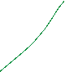

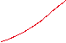

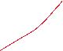





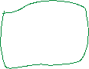

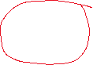


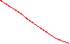





Interconnection Among Nodes

Slide 13
Design Issues for Neural Nets
Building a neural net to solve a given problem is partially art and partially science
Before we begin to train a net by finding the weights on the inputs that serve our goals, we have to make a number of design decisions.
How many hidden layers should we use?
How many nodes will there be in each of the hidden layers?
In what manner will we inter-connect the outputs of one layer to the inputs of the next layer?
What activation function to use at each node?
What cost function should we minimize to express what weights are the best?
How to compute the outputs of each node as a function of the inputs?
What algorithms shall we use to exploit the training examples in order to optimize the weights?

Slide 14
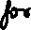
Dense Feed-forward Networks

Slide 15
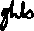
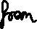
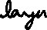
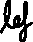
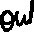
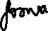
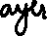
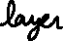
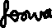
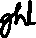
Information Flow

Slide 16

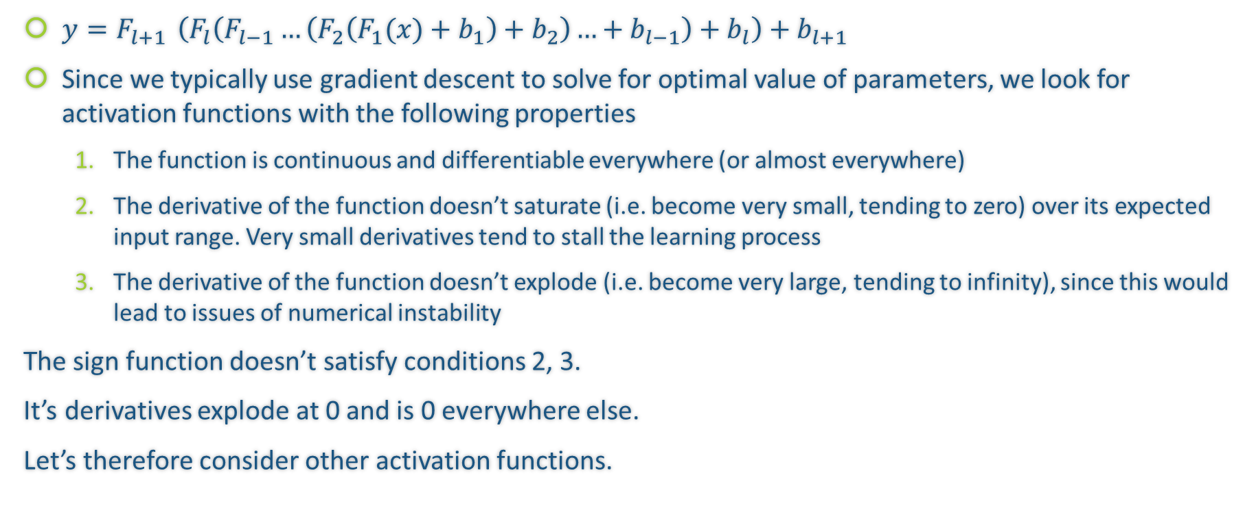
Activation Functions
$y=F_{l+1 }\left(F_{l}\left(F_{l−1}…\left(F_{2}\left(F_{1}(x)+b_{1}\right)+b_{2}\right)…+b_{l−1}\right)+b_{l}\right)+b_{l+1}$
Since we typically use gradient descent to solve for optimal value of parameters, we look for activation functions with the following properties
The function is continuous and differentiable everywhere (or almost everywhere)
The derivative of the function doesn’t saturate (i.e. become very small, tending to zero) over its expected input range. Very small derivatives tend to stall the learning process
The derivative of the function doesn’t explode (i.e. become very large, tending to infinity), since this would lead to issues of numerical instability
The sign function doesn’t satisfy conditions 2, 3.
It’s derivatives explode at 0 and is 0 everywhere else.
Let’s therefore consider other activation functions.
https://en.wikipedia.org/wiki/Dirac_delta_function

Slide 17
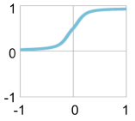
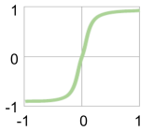
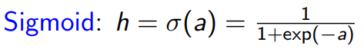
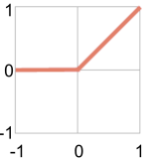
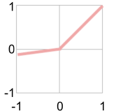
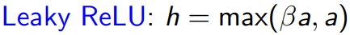
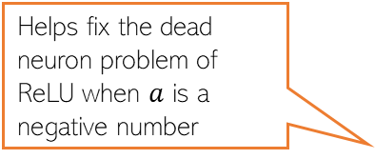
Activation Functions: Some Common Choices
sigmoid
tanh
For sigmoid as well as tanh, gradients saturate (become close to zero as the function tends to its extreme values)
Preferred more than sigmoid. Helps keep the mean of the next layer’s inputs close to zero (with sigmoid, it is close to 0.5)
h
h
a
a
ReLU
Leaky ReLU
ReLU and Leaky ReLU are among the most popular ones
Helps fix the dead neuron problem of ReLU when $a$ is a negative number
h
Without nonlinear activation, a deep neural network is equivalent to a linear model no matter how many layers we use
a

Slide 18
Commonly Used Activation Functions

Slide 19
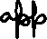
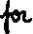

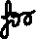




Softmax

Slide 20





Cross Entropy Loss

Slide 21



















Compute Graph

Slide 22


Gradients, Jacobians, and Chain Rule

Slide 23









Example of Backprop

Slide 24

Upstream and Local Gradients

Slide 25





Bonus Question 14.1 (5 marks)

Slide 27
Bonus Question 2.1 Solutions

Slide 28
BQ 2.2 solutions

Slide 29


BQ 2.3 Solutions

Slide 30


BQ 3.1 solution

Slide 31
BQ 3.2 solution

Slide 32

Backpropagation
32
Backpropagation = Gradient descent using chain rule of derivatives
Chain rule of derivatives: Example, if $y=f_{1}\left(x\right)$ and $x=f_{2}\left(z\right)$ then $\frac{∂y}{∂z}=\frac{∂y}{∂x}$ $\frac{∂x}{∂z}$
Start taking the derivatives of the loss function w.r.t. params of the last layer and then proceed backwards
Reuse already calculated gradients computed by the previous layer
Can reuse previous derivative computations due to the recursive nature of the neural net architecture

Slide 33








Backpropagation through an example
33

Slide 34
Backpropagation
34
Computes loss using current values of the parameters
Backprop iterates between a forward pass and a backward pass
Software frameworks such as Tensorflow and PyTorch support this already so you don’t need to implement it by hand (so no worries of computing derivatives etc)
Computes the gradient of the loss, starting with params in the last layer and going backwards
Backward Pass
Forward Pass
Using computational graphs

Slide 35


Example of Feed-forward Neural Network
num_inputs, num_outputs, num_hiddens = 784, 10, 256
W1 = nn.Parameter(
torch.randn(num_inputs, num_hiddens, requires_grad=True) * 0.01)
b1 = nn.Parameter(torch.zeros(num_hiddens, requires_grad=True))
W2 = nn.Parameter(
torch.randn(num_hiddens, num_outputs, requires_grad=True) * 0.01)
b2 = nn.Parameter(torch.zeros(num_outputs, requires_grad=True))
params = [W1, b1, W2, b2]

Slide 36

def relu(X):
a = torch.zeros_like(X)
return torch.max(X, a)
def net(X):
X = X.reshape((-1, num_inputs))
H = relu(X @ W1 + b1) # Here '@' stands for matrix multiplication
return (H @ W2 + b2)
loss = nn.CrossEntropyLoss()
num_epochs, lr = 10, 0.1
updater = torch.optim.SGD(params, lr=lr)
d2l.train_ch3(net, train_iter, test_iter, loss, num_epochs, updater)

Slide 37

Neural Nets: Some Aspects
37
Much of the magic lies in the hidden layers
Hidden layers learn and detect good features
Need to consider a few aspects
Number of hidden layers, number of units in each hidden layer
Why bother about many hidden layers and not use a single very wide hidden layer (recall Hornik’s universal function approximator theorem)?
Complex networks (several, very wide hidden layers) or simpler networks (few, moderately wide hidden layers)?
Aren’t deep neural network prone to overfitting (since they contain a huge number of parameters)?
Choosing the right NN architecture is important and a research area in itself. Neural Architecture Search (NAS) is an automated technique to do this

Slide 38



Representational Power of Neural Nets
38
Consider a single hidden layer neural net with $K$ hidden nodes
Recall that each hidden unit “adds” a function to the overall function
Increasing $K$ (number of hidden units) will result in a more complex function
Very large $K$ seems to overfit (see above fig). Should we instead prefer small $K$?
No! It is better to use large $K$ and regularize well. Reason/justification:
Simple NN with small $K$ will have a few local optima, some of which may be bad
Complex NN with large K will have many local optimal, all equally good (theoretical results on this)
We can also use multiple hidden layers (each sufficiently large) and regularize well
K = 3
K = 6
K = 20

Slide 39




Preventing Overfitting in Neural Nets
Various other tricks, such as weight sharing across different hidden units of the same layer (used in convolutional neural nets or CNN)
39
Neural nets can overfit. Many ways to avoid overfitting, such as
Standard regularization on the weights, such as $ℓ_{2},ℓ_{1}$, etc ($ℓ_{2}$ reg. is also called weight decay)
Early stopping (traditionally used): Stop when validation error starts increasing
Dropout: Randomly remove units (with some probability $p∈ (0,1)$) during training
Single Hidden Layer NN with K = 20 hidden units and L2 regularization
Fig courtesy: Dropout: A Simple Way to Prevent Neural Networks from Overfitting (Srivastava et al, 2014)

Slide 40

Wide or Deep?
40
While very wide single hidden layer can approx. any function, often we prefer many, less wide, hidden layers
Higher layers help learn more directly useful/interpretable features (also useful for compressing data using a small number of features)

Slide 41

Using a Pre-trained Network
41
A deep NN already trained in some “generic” data can be useful for other tasks, e.g.,
Feature extraction: Use a pre-trained net, remove the output layer, and use the rest of the network as a feature extractor for a related dataset
Fine-tuning: Use a pre-trained net, use its weights as initialization to train a deep net for a new but related task (useful when we don’t have much training data for the new task)
This part of a pre-trained net can be used as a feature extractor on some new task
Many packages, like Tensorflow and PyTorch provide such pre-trained module ready to be used
Sometimes also known as “transfer learning” in the context of neural nets

Slide 42
Deep Neural Nets: Some Comments
42
Highly effective in learning good feature rep. from data in an “end-to-end” manner
The objective functions of these models are highly non-convex
But fast and robust non-convex opt algos exist for learning such deep networks
Training these models is computationally very expensive
But GPUs can help to speed up many of the computations
Also useful for unsupervised learning problems (will see some examples)
Autoencoders for dimensionality reduction
Deep generative models for generating data and (unsupervisedly) learning features – examples include generative adversarial networks (GAN) and variational auto-encoders (VAE)

Slide 58
Constrained Optimization

Slide 59
Projected Gradient Descent
Consider an optimization problem of the form
Projected GD is very similar to GD with an extra projection step
Each iteration $t$ will be of the form
Perform update: $z^{(t+1)}= w^{(t)}−η_{t}g^{(t)}$
Check if $z^{(t+1)}$ satisfies constraints
If $z^{(t+1)}∈𝒞,$set $w^{(t+1)}$= $z^{(t+1)}$
If $z^{(t+1)}∉𝒞,$ project as $w^{(t+1)}$= $Π_{𝒞}[z^{(t+1)}]$
$w_{opt}= {arg min}_{w∈𝒞}$ $L(w)$
Projection
step
Projection operator

Slide 60


Projected GD: How to Project?
Here projecting a point means finding the “closest” point from the constraint set
For some sets $𝒞$, the projection step is easy
$Π_{𝒞}\left[z\right]={arg min}_{w∈𝒞}$ ${\left\|z−w\right\|}^{2}$
Projected GD commonly used only when the projection step is simple and efficient to compute
$𝒞$: Unit radius $ℓ_{2}$ball
$𝒞$: Set of non-negative reals
(0,1)
(1,0)
Projection = Normalize to unit Euclidean length vector
Projection = Set each negative entry in $z$ to be zero

Slide 61
Proximal Gradient Descent
Consider minimizing a regularized loss function of the form
Proximal GD popular when regularizer $R(w)$ is non-differentiable
Basic idea: Do GD on $L(w)$ and use a prox. operator to regularize via $R(w)$
For a func. $R$, its prox. operator is ${prox}_{R}\left(z\right)=\arg{\min_{w}\left[R\left(w\right)+\frac{1}{2}{\left\|z−w\right\|}_{2}^{2}\right]}$
${arg min}_{w} L(w) + R(w)$
Note: The reg. hyperparam. $λ$ assumed part of $R(w)$ itself
Proximal GD
Special Cases
That is, regularize by reducing the value of each component of the the vector $z$ by half
Assume reg. loss function of the form $L(w) + R(w)$
Initialize $w$ as $w^{(0)}$
For iteration $t=0,1,2,…$(or until convergence)
Calculate the (sub)gradient of train. Loss (w/o reg.)
$g^{(t)}∈∂L\left(w^{\left(t\right)}\right)$
Set learning rate $η_{t}$
Step 1: $z^{(t+1)}= w^{(t)}−η_{t}g^{(t)}$
Step 2: $w^{(t+1)}={prox}_{R}\left(z^{(t+1)}\right)$
For $R\left(w\right)=0.5×{\left\|w\right\|}_{2}^{2}$
$prox_{R}\left(z\right)=z/2$ i.e. scaling
If $R\left(w\right)$ defines a set based constraint
$R(w)$ := $w∈𝒞$
$$prox_{R}\left(z\right)= {arg min}_{w∈𝒞} {\left\|z−w\right\|}^{2}$$
Prox. GD becomes equivalent to projected GD

Slide 62




Constrained Opt. via Lagrangian
Consider the following constrained minimization problem (using $f$ instead of $L$)
Note: If constraints of the form $g\left(w\right)≥ 0$, use $–g\left(w\right)≤ 0$
Can handle multiple inequality and equality constraints too (will see later)
Can transform the above into the following equivalent unconstrained problem
Our problem can now be written as

Slide 63


Constrained Opt. via Lagrangian
The Lagrangian: $ℒ(w,α)$
Therefore, we can write our original problem as
The Lagrangian is now optimized w.r.t. $w$ and $α$ (Lagrange multiplier)
We can defined Primal and Dual problem as
Both equal if $f(w)$ and the set $g\left(w\right)≤ 0$are convex
complimentary slackness/Karush-Kuhn-Tucker (KKT) condition
https://en.wikipedia.org/wiki/Karush%E2%80%93Kuhn%E2%80%93Tucker_conditions
MA605

Slide 64


Constrained Opt. with Multiple Constraints
We can also have multiple inequality and equality constraints
Introduce Lagrange multipliers $α=[α_{1},α_{2},…,α_{K}]$ and $β=\left[β_{1},β_{2},…,β_{L}\right]$
The Lagrangian based primal and dual problems will be

Slide 65
Some other useful optimization methods

Slide 66
Co-ordinate Descent (CD)
Standard gradient descent update for : $w^{(t+1)}= w^{(t)}−η_{t}g^{(t)}$
CD: In each iter, update only one entry (co-ordinate) of $w$. Keep all others fixed
Cost of each update is now independent of $D$
In each iter, can choose co-ordinate to update unif. randomly or in cyclic order
Instead of updating a single co-ord, can also update “blocks” of co-ordinates
Called Block co-ordinate descent (BCD)
To avoid $O(D)$ cost of gradient computation, can cache previous computations
Recall that grad. computations may have terms like $w^{⊤}x$ – if just one co-ordinate of w changes, we should avoid computing the new $w^{⊤}x$ $(=\sum_{d}{w_{d}x_{d)}}$ from scratch
Ⓣ
$w_{d}^{(t+1)}= w_{d}^{(t)}−η_{t}g_{d}^{(t)}$ $d∈\{1,2,…,D\}$
$g_{d}=∇_{w_{d}}L\left(w\right)$ -- partial derivative w.r.t. the $d^{th}$ element of vector $w$ (or the $d^{th}$ element of the gradient vector g)
=

Slide 67


Alternating Optimization (ALT-OPT)
Consider opt. problems with several variables, say two variables $w_{1}$ and $w_{2}$
Often, this “joint” optimization is hard/impossible to solve
We can take an alternating optimization approach to solve such problems
Usually converges to a local optima. But very very useful. Will see examples later
Also related to the Expectation-Maximization (EM) algorithm which we will see later

Slide 68

Newton’s Method
Unlike GD and its variants, Newton’s method uses second-order information (second derivative, a.k.a. the Hessian)
At each point $w^{(t)}$, minimize the quadratic (second-order) approx. of $L(w)$
$w^{(t+1)}={arg min}_{w}$ [$L\left(w^{\left(t\right)}\right)+∇{L\left(w^{\left(t\right)}\right)}^{⊤}\left(w−w^{\left(t\right)}\right)+\frac{1}{2}{(w−w^{\left(t\right)})}^{⊤}∇^{2}L\left(w^{\left(t\right)}\right)$ $(w−w^{\left(t\right)})$]
$$L(w)$$
Show that $w^{(t+1)}=w^{\left(t\right)}− {\left(∇^{2}L\left(w^{\left(t\right)}\right)\right)}^{−1}∇L\left(w^{\left(t\right)}\right)$
$=$ $w^{\left(t\right)}−{{(H}^{\left(t\right)})}^{−1}g^{\left(t\right)}$
Converges much faster than GD (very fast for convex functions). Also no “learning rate”. But per iteration cost is slower due to Hessian computation and inversion
Faster versions of Newton’s method also exist, e.g., those based on approximating Hessian using previous gradients (see L-BFGS which is a popular method)
$$w^{(1)}$$
$$w_{opt}$$
$$w$$

Slide 69

Some Practical Aspects: Initialization
Iterative opt. algos like GD, SGD, etc need to be initialized to “good” values
Bad initialization can result on bad local optima
Mainly a concern for non-convex loss functions, not so much for convex loss functions
Transfer Learning: Initialize using params of a model trained on a related dataset
Initialize using solution of a simpler but related model
E.g., for multitask regression (say $T$ coupled regression problems), initialize using the solutions of the $T$ independently trained regression problems
For deep learning models, initialization is very important
Transfer learning approach is often used (initialize using “pre-trained” model from another dataset)
Bad initialization can make the model be stuck at saddle points. Need more care.
Random restarts: Running with several random initializations can often help
But still be careful with learning rate
If the goal is to learn the same model but for a different training set

Slide 70





Some Practical Aspects: Assessing Convergence
Various ways to assess convergence, e.g. consider converged if
The objective’s value (on train set) ceases to change much across iterations
The parameter values cease to change much across iterations
Above condition is also equivalent to saying that the gradients are close to zero
The objective’s value has become small enough that we are happy with ☺
Use a validation set to assess if the model’s performance is acceptable (early stopping)
$L(w^{(t+1)}$) - $L\left(w^{\left(t\right)}\right)<ε$
(for some small pre-defined $ε$)
$\left\|{ w}^{(t+1)} −{ w}^{(t)}\right\|<τ$
(for some small pre-defined $τ$)
$\left\|{ g}^{(t)}\right\|→$0
Caution: May not yet be at the optima. Use at your own risk!

Slide 71



Some Practical Aspects: Learning Rate (Step Size)
Some guidelines to select good learning rate (a.k.a. step size) $η_{t}$
For convex functions, setting $η_{t}$ something like $C/t$ or $C/\sqrt{t}$often works well
These step-sizes are actually theoretically optimal in some settings
In general, we want the learning rates to satisfy the following conditions
$η_{t}→0$as $t$ becomes very very large
$\sum{η_{t}}=∞$ (needed to ensure that we can potentially reach anywhere in the parameter space)
Sometimes carefully chosen constant learning rates (usually small, or initially large and later small) also work well in practice
Can also search for the “best” step-size by solving an opt. problem in each step
An faster alternative to line search is the Armijo-Goldstein rule
Starting with current (or some large) learning rate (from prev. iter), and try a few values in decreasing order until the objective’s value has a sufficient reduction
C is a hyperparameter
Also called “line search”
$$η_{t}=\arg{\min_{η≥0}{f\left(w^{(t)}−η⋅g^{(t)}\right)}}$$
A one-dim optimization problem (note that $w^{(t)}$ and $g^{(t)}$ are fixed)

Slide 72





Some Practical Aspects: Adaptive Gradient Methods
If some dimension had big updates recently (marked by large gradient values), show down along those directions by using smaller learning rates - AdaGrad
(Duchi et al, 2011)
Can also use different learning rate in different dimensions
$w^{(t+1)}= w^{(t)}−e^{(t)}{⊙g}^{(t)}$
Can use a momentum term to stabilize gradients by reusing info from past grads
Move faster along directions that were previously good
Slow down along directions where gradient has changed abruptly
Also exists several more advanced methods that combine the above methods
RMS-Prop: AdaGrad + Momentum, Adam: NAG + RMS-Prop
These methods are part of packages such as PyTorch, Tensorflow, etc
$$e_{d}^{(t)}= \frac{1}{\sqrt{ε+\sum_{τ=1}^{t}{{\left(g_{d}^{(t)}\right)}^{2}}}}$$
Vector of learning rates along each dimension
Element-wise product of two vectors
In an even faster version of this, $g^{(t)}$ is replaced by the gradient computed at the next step if previous direction were used, i.e., $∇L(w^{\left(t\right)}−{βm}^{(t−1)}$).
Called Nesterov’s Accelerated Gradient (NAG) method
The “momentum” term. Set to 0 at initialization
$$m^{(t)}={βm}^{(t−1)}+η_{t}g^{(t)} \\ w^{(t+1)}←w^{(t)}−m^{(t)}$$
$β$ usually set as 0.9

Slide 73
Optimization for ML: Some Final Comments
Gradient methods are simple to understand and implement
More sophisticated optimization methods also often use gradient methods
Backpropagation algo used in deep neural nets is GD + chain rule of differentiation
Use subgradient methods if function not differentiable
Constrained optimization can use Lagrangian or projected/proximal GD
Second order methods such as Newton’s method faster but computationally expensive
But computing all this gradient related stuff by hand looks scary to me. Any help?
Don’t worry. Automatic Differentiation (AD) methods available now (will see them later)
AD only requires specifying the loss function (especially useful for deep neural nets)
Many packages such as Tensorflow, PyTorch, etc. provide AD support
But having a good understanding of optimization is still helpful

